Slide 1

AI & DATA
JOB MARKET ANALYSIS
MAHMOUD MOHAMED SOLIMAN
Junior Data Analyst

Slide 2

INTRODUCTION
The AI and Data industry has experienced significant changes in job opportunities, salaries, and work arrangements over the past few years.
IN this project analyzes AI and Data job market data from 2020 to 2024 to explore salary trends and the factors influencing compensation, such as experience level, company size, and work type.
Using Python for data preparation and Power BI for visualization, the project aims to provide insights that support data-driven HR decisions.

Slide 3
BUSINESS CASE

Slide 4



BUSINESS PROBLEM
HR teams need a clearer understanding of how the AI and Data job market has evolved between 2020 and 2024.
The analysis focuses on identifying changes in salary levels, job market activity, and compensation differences across various employee and company characteristics.
By analyzing these patterns, HR professionals can gain a better understanding of the market and use data to support workforce planning and compensation analysis.

Slide 5

KEY BUSINESS QUESTIONS
01
Job Market TrendsJob Market Trends
How have salaries and job demand changed from 2020 to 2024?
02
Salary Drivers
How do experience level, company size, and job category influence salaries?
03
Workforce Distribution
How are jobs distributed across Remote, Onsite, and Hybrid work arrangements?

Slide 6

PROJECT OBJECTIVES
OBJECTIVES
  Analyze salary trends between 2020 and 2024.
  Examine changes in the number of recorded jobs over time.
  Compare compensation across job categories and experience levels.
  Analyze the relationship between company size and salary.
  Explore work arrangements across different job categories.
  Present actionable insights through interactive Power BI dashboards.

Slide 7
OVERVIEW
Notes:
This dashboard provides an overview of the AI & Data job market, focusing on job volume, salary levels, remote work, and workforce distribution.

Slide 8
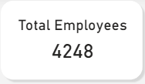

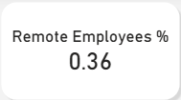
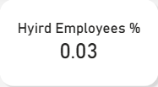
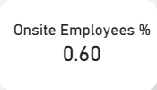
DATA OVERVIEW

Slide 9
DATA OVERVIEW

Slide 10
DATA OVERVIEW

Slide 11
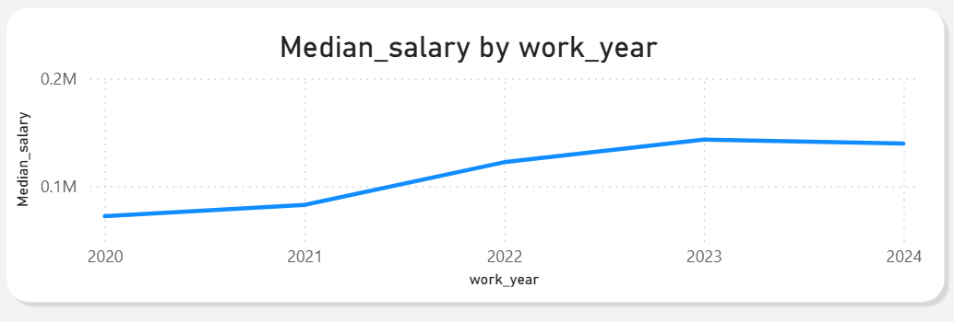
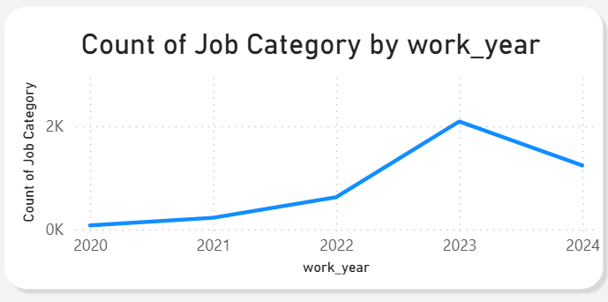
DATA JOBS MARKET
JOBS COUNT OVER YEARS
SALARY OVER YEARS
Notes:
هنا هتتكلم عن التغير ف المرتب وعدد الوظايف وممكن تشرح حتة 2023 انها بتبقي اعلي من 2024 وده بسبب القفذه لدخول ال Ai models زي شات جي بي تي فبقت تريند اثر لكن بعد كده نقدر نقول زي 2024 الصعود كمل بس بطبيعيه واسال شات برده تظظبها ازاي

Slide 12
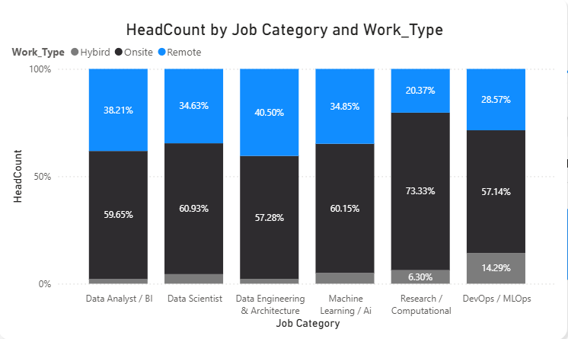
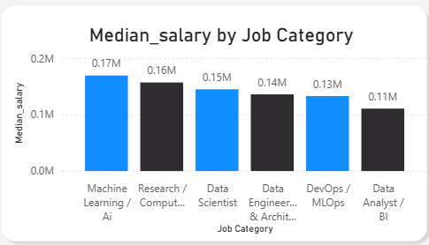
DATA JOBS MARKET
REMOTE & ON-SITE RATIO BY JOB
MEDIAN SALARY BY JOB FIELD
Notes:
بنستخدم ال median لان في قيم كبيره كده وبرده فنفس الوقت القيم دي مهمه مش عاوزين نهملها

Slide 13
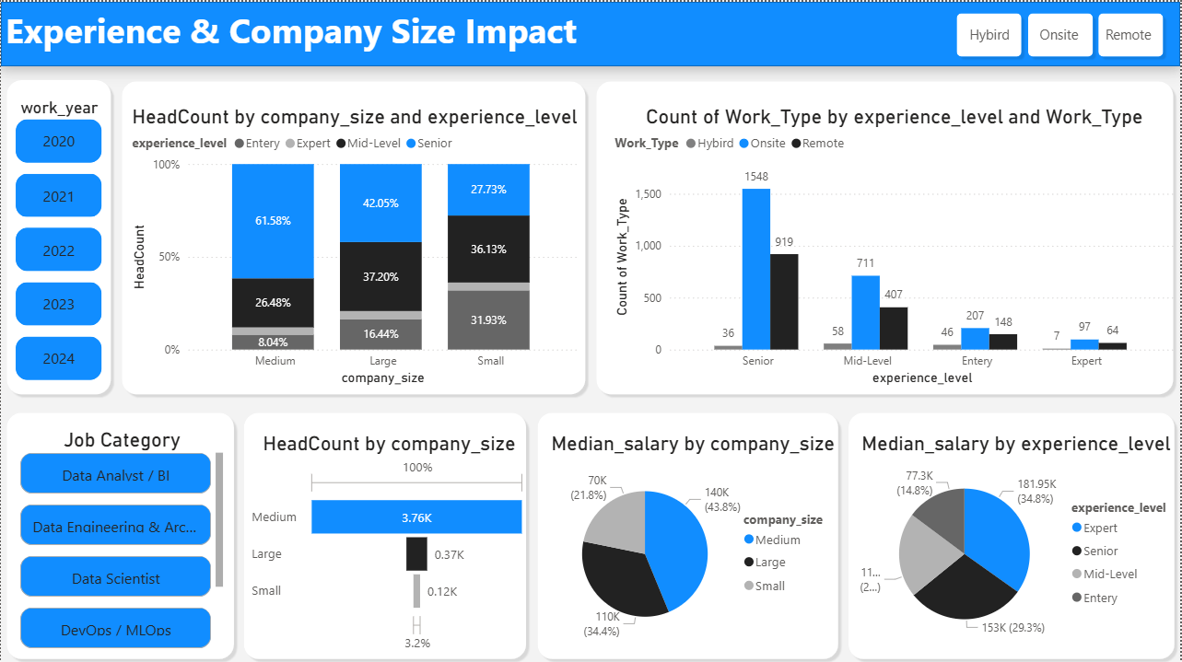
EXPREIENCE & COMPAY
IMPACT
Notes:
بنستخدم ال median لان في قيم كبيره كده وبرده فنفس الوقت القيم دي مهمه مش عاوزين نهملها

Slide 14
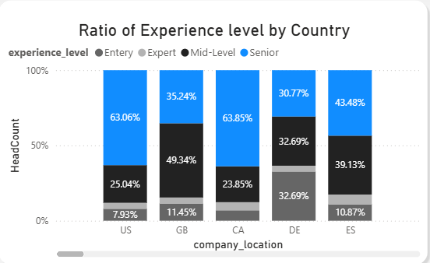
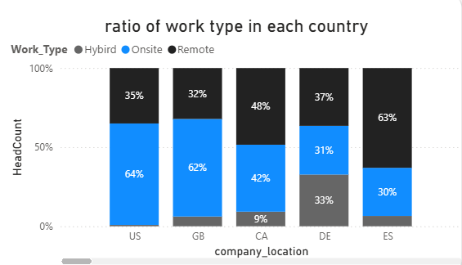
DATA JOBS MARKET
COUNT OF COMPANIES IN EACH COUNTRY
COUNT OF WORK TYPE IN EACH COUNTRY
Notes:
بنستخدم ال median لان في قيم كبيره كده وبرده فنفس الوقت القيم دي مهمه مش عاوزين نهملها

Slide 15
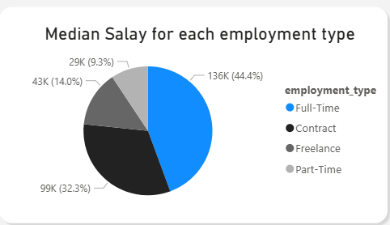
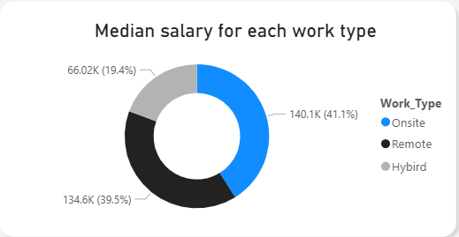
IMPACT ON SALARY
SALARY BY EMPLOYMENT TYPE
SALARY BY WORK TYPE
Notes:
بنستخدم ال median لان في قيم كبيره كده وبرده فنفس الوقت القيم دي مهمه مش عاوزين نهملها

Slide 16
KEY INSIGHTS
1- The AI & Data market expanded in both job volume and salaries, while salary levels remained relatively close across data roles.
2- Seniority is a key salary driver, with On-site and Full-time roles showing higher median salaries.
3- Medium-sized companies recorded higher average salaries, but company-size comparisons should be interpreted with caution due to uneven job representation.

Slide 17
CONTACT ME
THANKS
Phone
Email
+201152987989
mahmoudsoliman1503@gmail.com

